Slide 1
Self Introduction

Slide 2
Hello!
My name is
Rukeme
You can call me
Mr. Rukeme

Slide 3

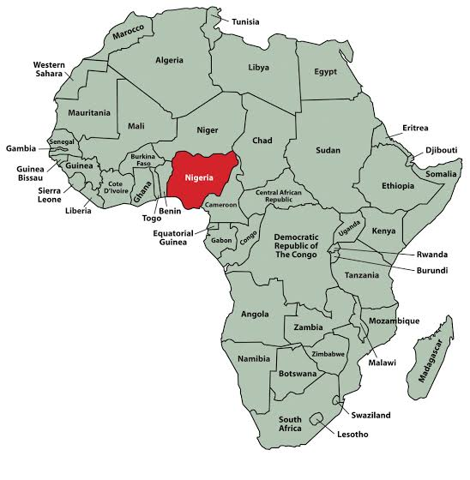
I’m from Nigeria.

Slide 4
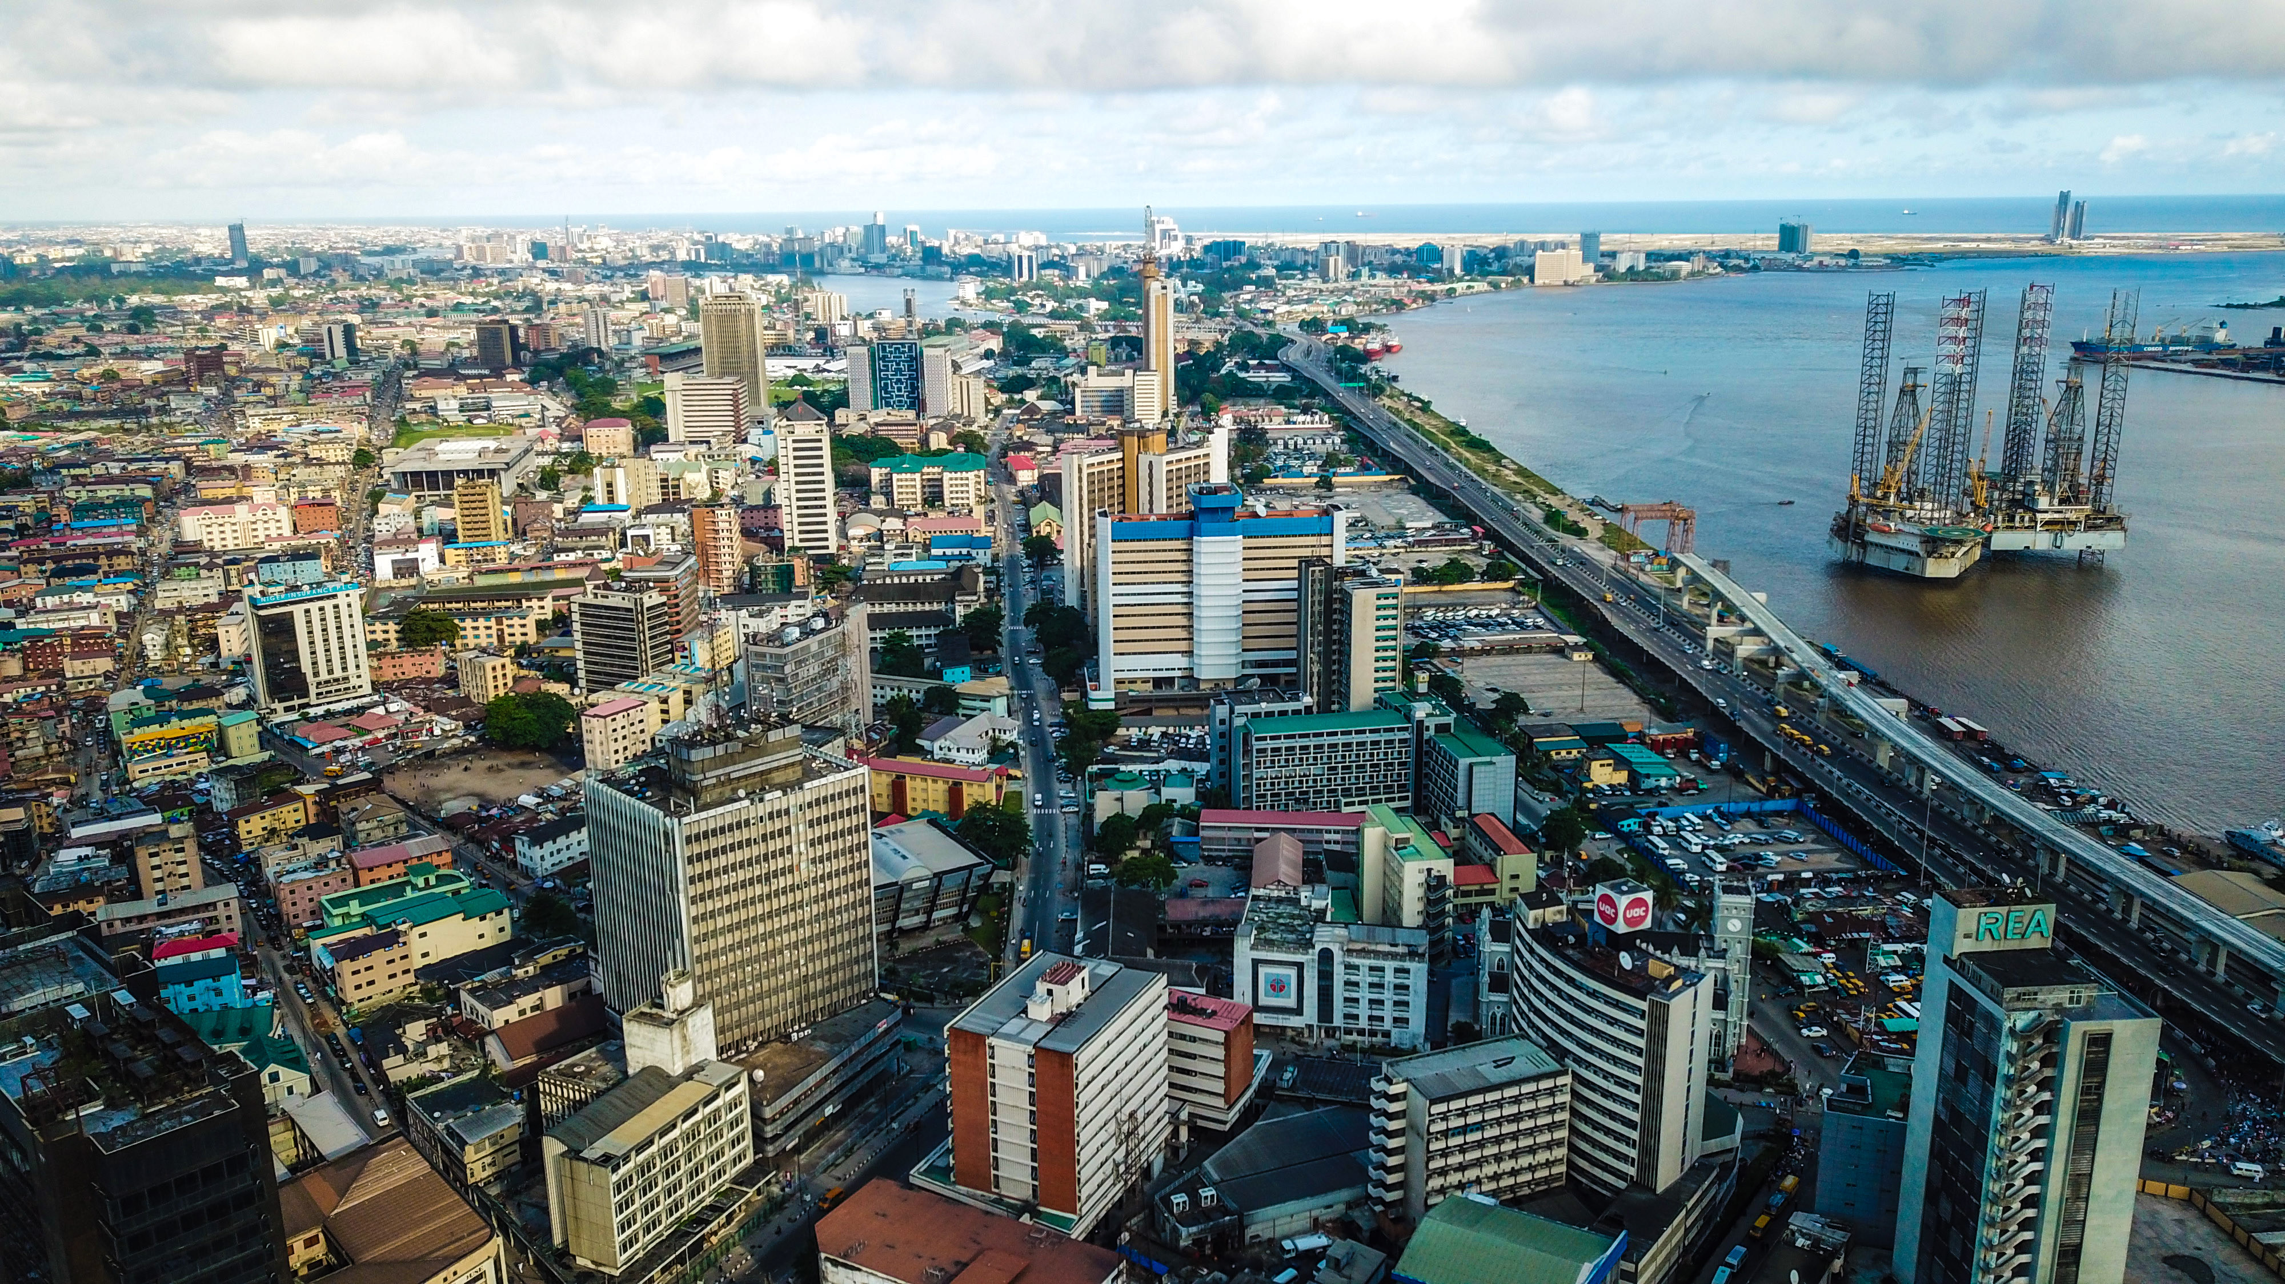
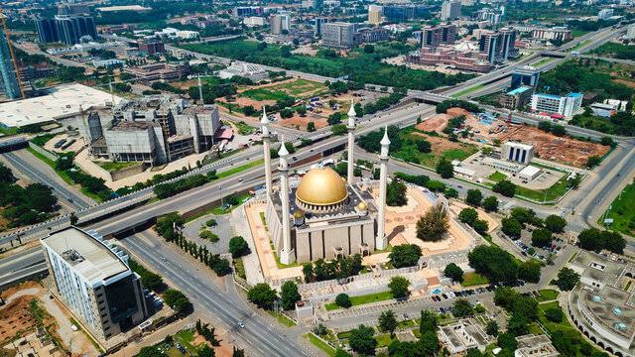
Nigeria
Abuja
Lagos

Slide 5
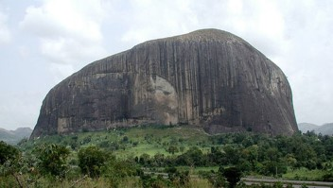
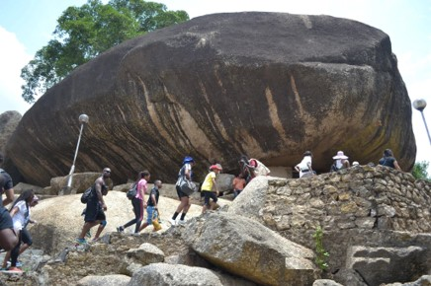
Nigeria
Zuma rock
Olumo rock
You can go rock climbing in Nigeria.

Slide 6
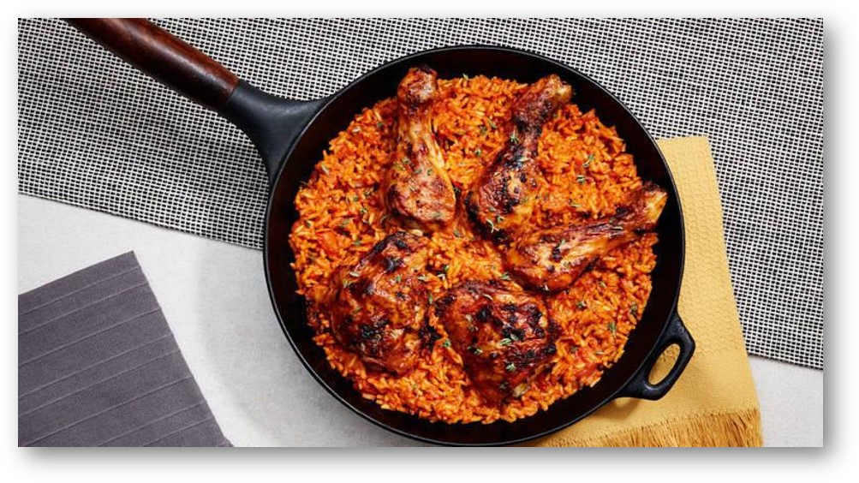
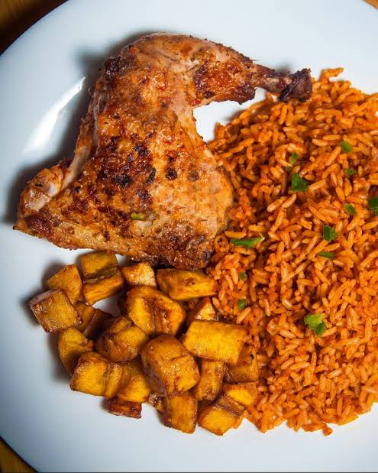
Nigeria has...
Jollof rice.

Slide 7


Nigerian greetings
Good morning - Ekaaro
See you- Odaabo

Slide 8
I like Blue.

Slide 9

My Birthday is January 17th.

Slide 10




I like anime.

Slide 11
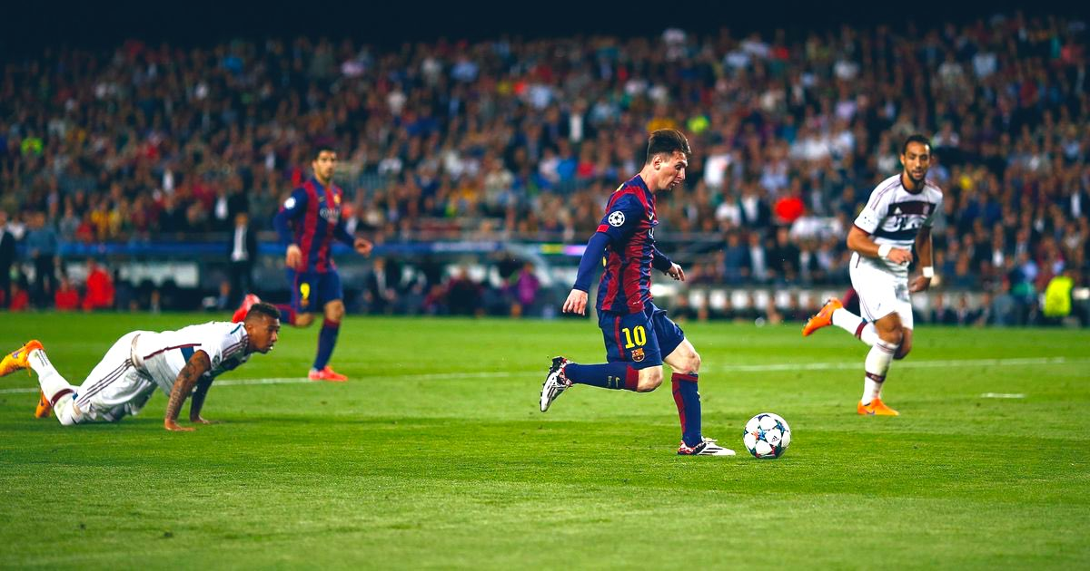
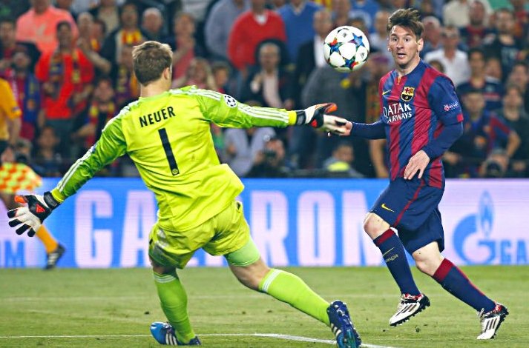
I like soccer.

Slide 12
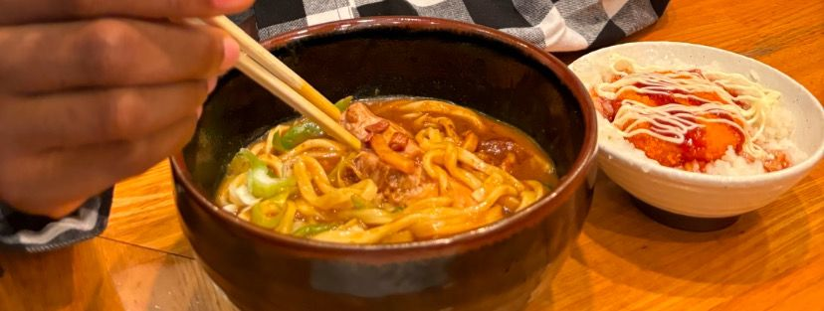
I like Curry Udon.

Slide 13
Thank you for listening.
Let’s have fun studying English!

Slide 14

Questions & Quiz

Slide 15
1. What is my favorite color?
Blue

Slide 16
2. What country am I from?
Nigeria

Slide 17
3. What sport do I like?
Soccer

Slide 18
4. What food do I like?
Curry
Udon

Slide 19
Thank you!

